Slide 1
Experimental Analysis of GraphRAG
A novel approach for join discovery
Candidato: Bilel Arfaoui
Relatore: Giovanni Simonini
Università di Modena e Reggio Emilia
Anno Accademico 2023/2024

Slide 2
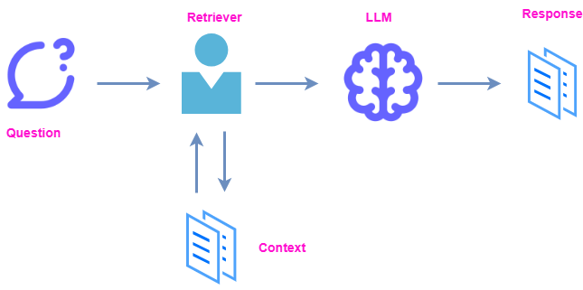
Retrieval Augmented Generation

Slide 3
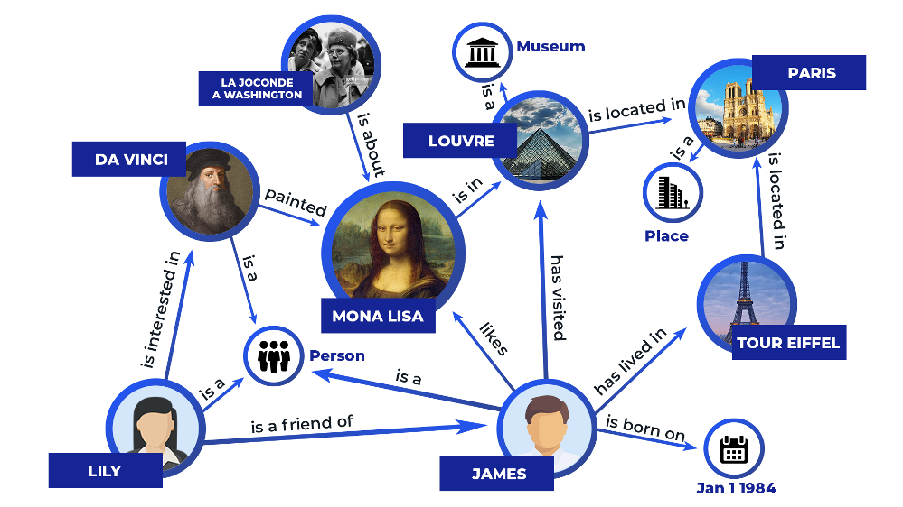
Knowledge Graphs

Slide 4
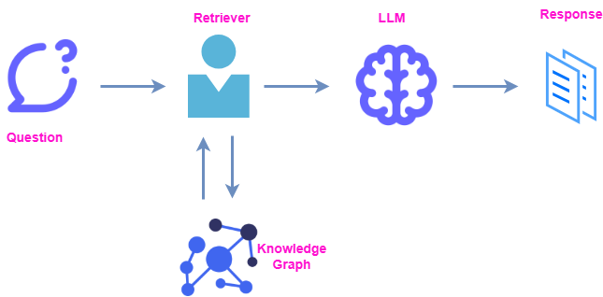
Graph RAG

Slide 5
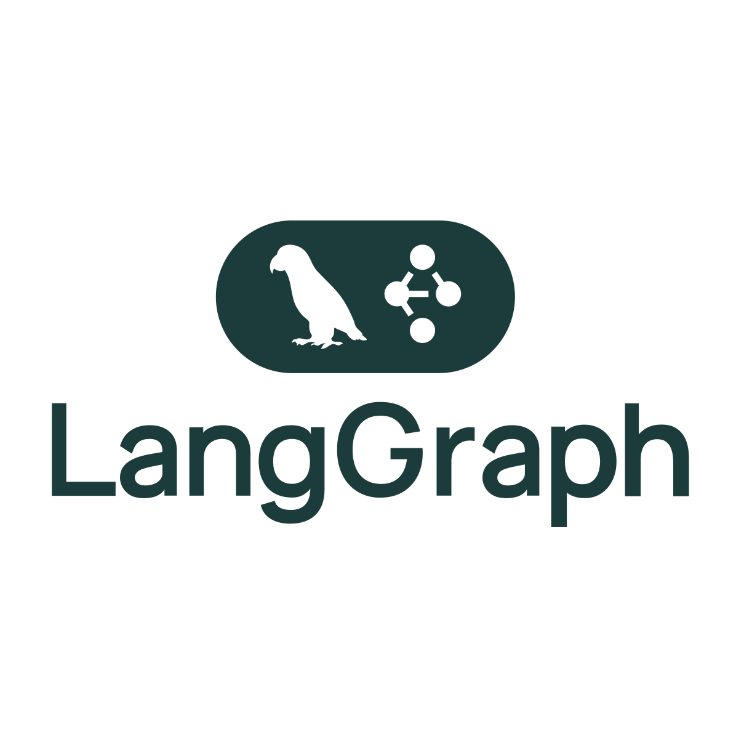


Core Tech Stack

Slide 6
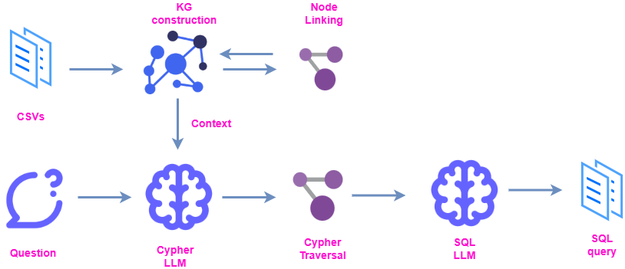
Proposed Solution

Slide 7
Motivations
Structured queries from natural language
No need to be an SQL expert
No need to be a domain expert
Work over multi lingual datasets
The ability to setup complex queries by using the insights offered by the KG

Slide 8
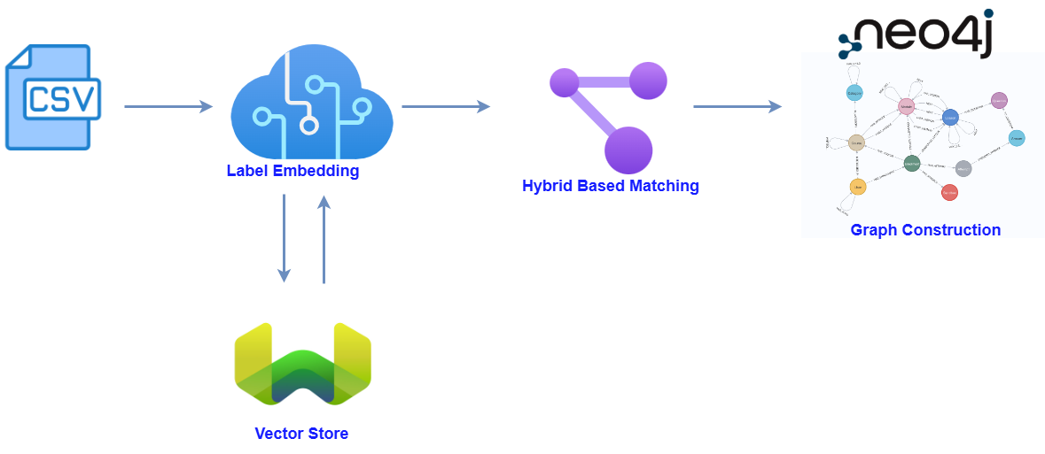
Knowledge Graph construction

Slide 9
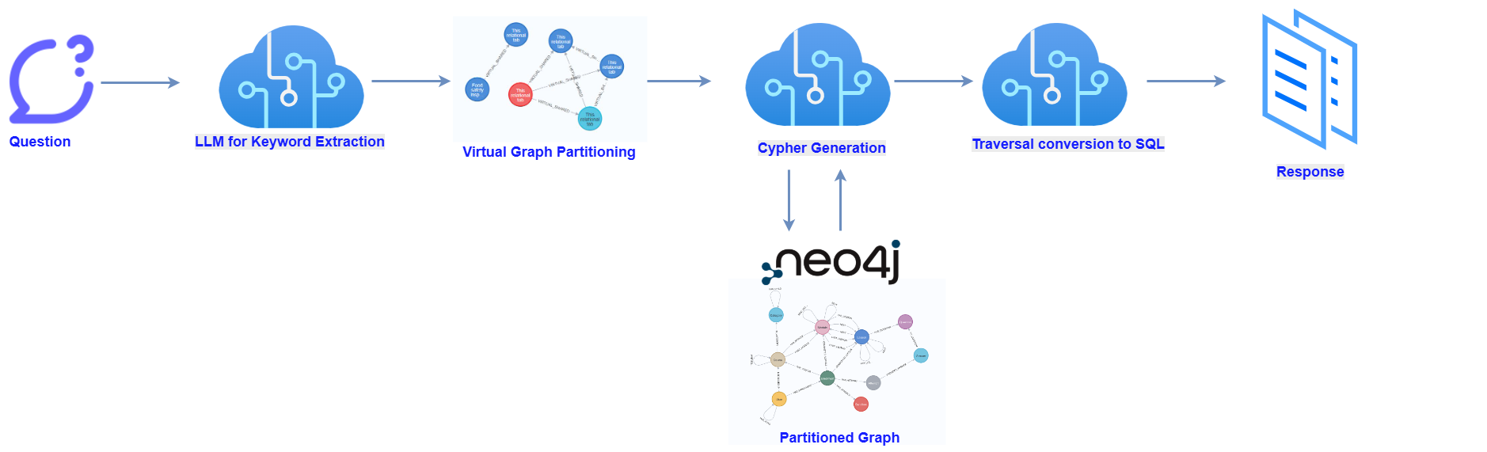
Query processing pipeline

Slide 10
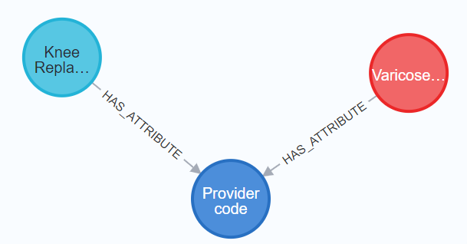
Experiment over UK/CAN Opendata
Question: “What is the average count of varicose vein post-op questions left front for knee replacement patients readmitted to hospital, by age band and provider code?”
Resulting Traversal:

Slide 11
Experiment over UK/CAN Opendata
Resulting SQL:
SELECT age_band, provider_code, AVG(PostOpQLeftFrontCount) AS average_count
FROM Varicose Vein JOIN KneeReplacement ON ProviderCode
WHERE Procedure = 'knee replacement' AND readmitted = ‘Yes’
GROUP BY AgeBand, ProviderCode

Slide 12
Framework Evaluation
Accurate NL-to-SQL on UK/Canada OpenData
Knowledge Graphs improved complex schema handling
Cypher-based retrieval reduced join/column errors
Outperforms keyword-based methods on intricate queries
Combines Knowledge Graphs + LLMs for expert-level querying

Slide 13
Thank you for your attention!

